Slide 1
REGULARIZATION and OPTIMIZATION
Bakul Gohel, Ph.D.
DA-IICT, Gandhinagar

Slide 2
Optimization

Slide 3
Stochastic Gradient Descent (SGD)
Gradient Descent
To update the weight in one iteration or epoch, gradient computed from each of examples that means entire batch….and averaged gradient is computed
Stochastic Gradient Descent
To update the weight in one iteration or epoch, gradient computed from single or small subset of examples that means mini batch….and averaged gradient is computed

Slide 5
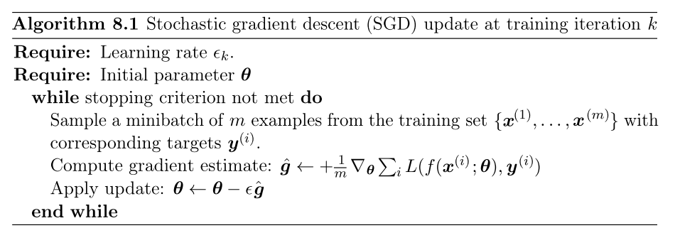
Stochastic Gradient Descent (SGD)
Note: Epoch: each example in a dataset provides opportunity to update parameter

Slide 6
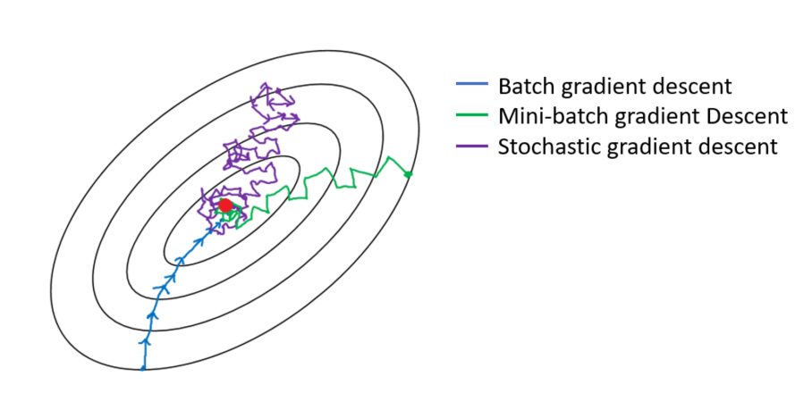
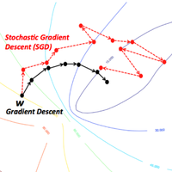
Stochastic Gradient Descent (SGD)
Computationally efficient
Not all samples in memory to gradient
Frequent model update, ..and bit noisy,
Avoid or escape from local minima, better convergence

Slide 7

Stochastic Gradient Descent (SGD)
In practice, it is common to decay the learning rate
$$η=η∗\frac{1}{1+decay rate∗epoch}$$

Slide 8
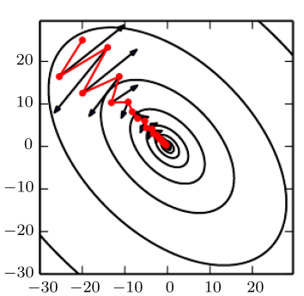
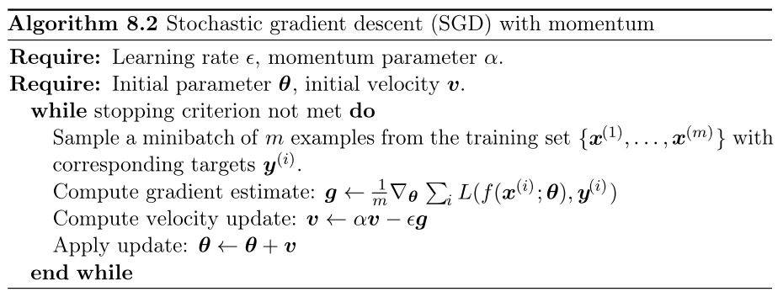
SGD with Momentum
Parameter update considering previous gradient and present gradient
accelerate learning, especially in the face of high curvature, small but consistent gradients, or noisy gradients

Slide 9
Adaptive Learning rate
Fixed learning rate to all parameters is inefficient approach…
It should be adaptive
Consideration of past and present gradient

Slide 10
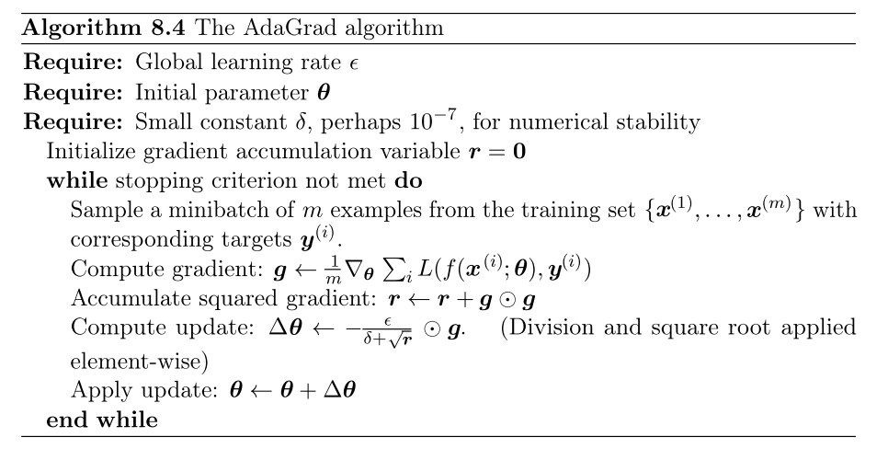
AdaGrad
Individually adapts the learning rates of all model parameters by scaling them inversely proportional to the square root of the sum of all of their historical squared values

Slide 11
AdaGrad
Likely lead to premature and excessive decrease in the eﬀective learning rate
Net eﬀect is greater progress in the more gently sloped directions of parameter space

Slide 12
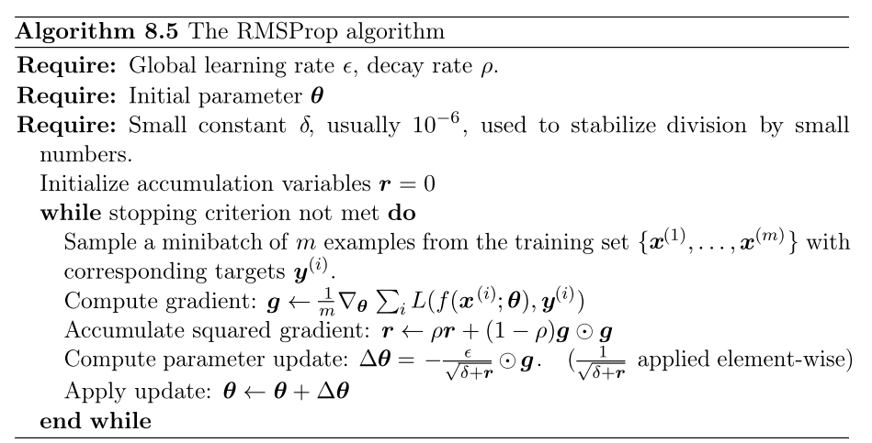
RMSProp
modiﬁes AdaGrad: change the gradient accumulation into weighted moving average
Correct adagrad for premature and excessive decrease in the eﬀective learning rate

Slide 13
Adam
Variant on the combination of RMSProp and momentum
First and second order moments with bias corrections

Slide 14
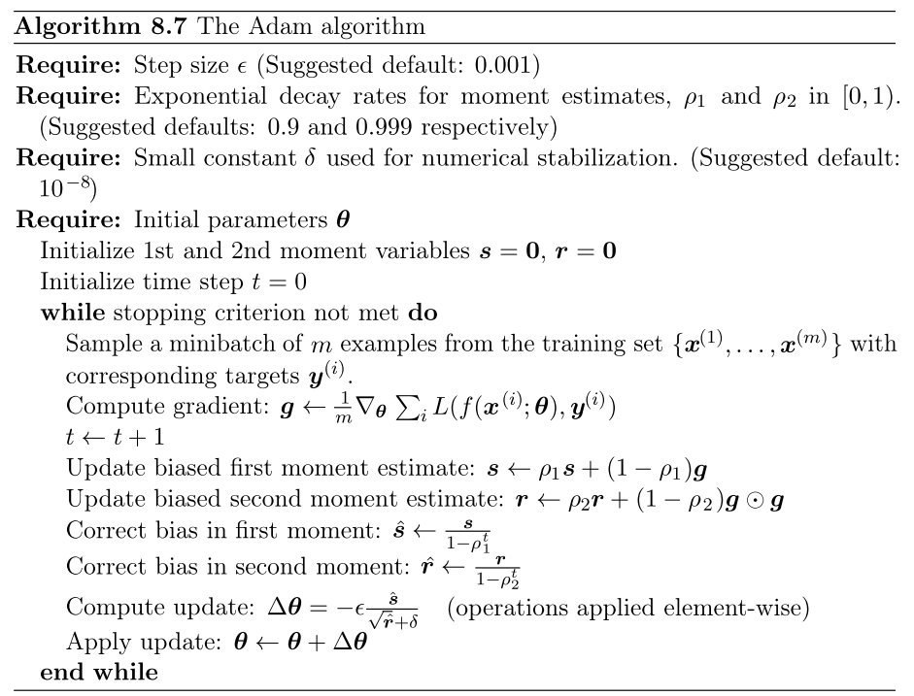
Adam

Slide 15
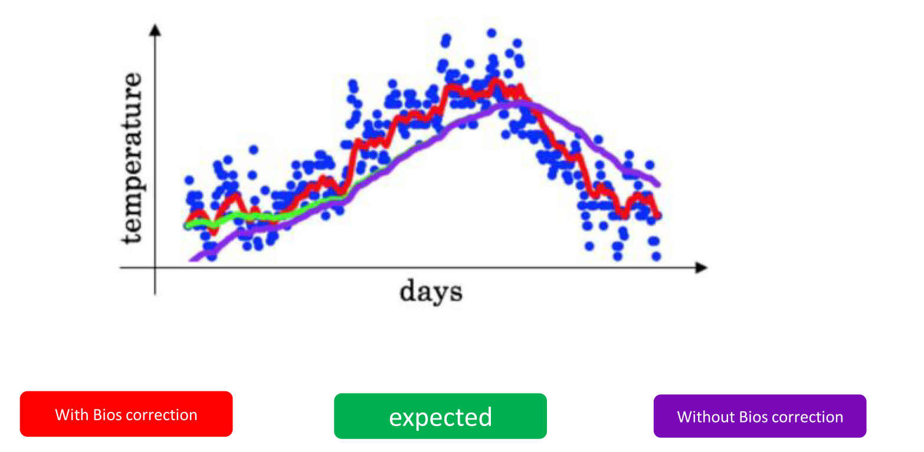

Slide 16
Generalization

Slide 17
Preparing Dataset
Model training and Evaluation generally we need to portioned the as follow
Available Labelled Data
Training Set
Validation Set
Testing Set
Model Parameter Tuning
Model Validation
Model
Training an Tuning
Model Evaluation

Slide 18
Generalization
Optimization:
Error Minimization
Machine Learning:
Error minimization on training data….
But…
Desire, minimum error on test data…!!!

Slide 19
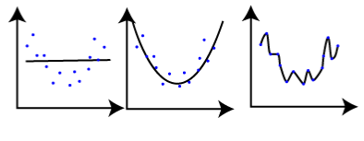
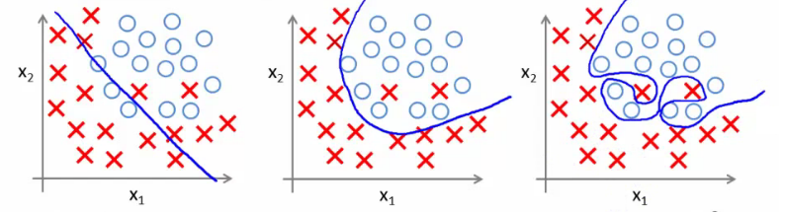
Under/Over-fitting
Under-fitting
/
Low capacity network
Over-fitting
/
High capacity network
Function
Approximation
https://shapeofdata.files.wordpress.com/2013/03/cropped-blogtop5.png
Classification
Source: http://www.holehouse.org/mlclass/07_Regularization_files/Image%20[1].png

Slide 20
Under/Over-fitting
Higher the number of parameters in a model
Have bigger functional space
Or have higher capacity
Or can approximate very complex functions
Increasing number of nodes in ANN so that numbers of parameter increases the model capacity
Can we determine the required model capacity ?
Numbers of hidden layers required ?
Numbers of nodes in a hidden layers ?

Slide 21
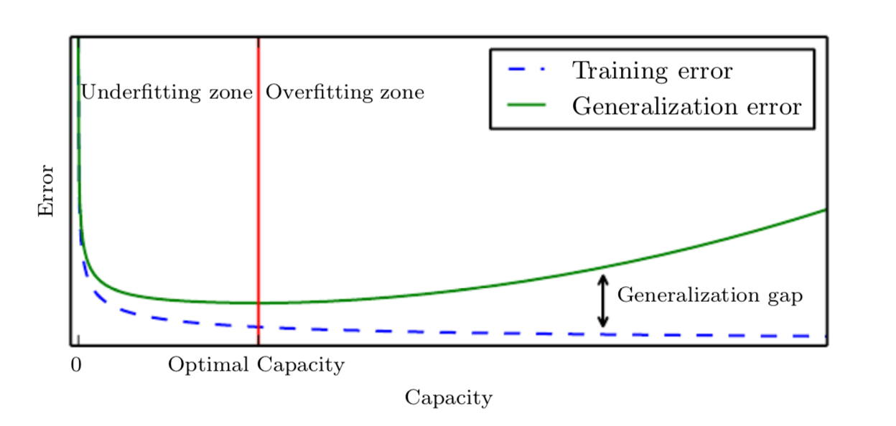
Generalization and Model capacity
Optimal capacity is that minimize the generalization error

Slide 22
Regularization

Slide 23
Regularization
any modiﬁcation we make to a learning algorithm that is intended to reduce its generalization error but not its training error
Empirical approach…best solution not guaranteed….

Slide 24
Regularization Techniques
Early Stopping
Parameter Norm Penalties
Node Dropout in hidden layer
Multiple model or Ensemble Methods
Plugging noise in input and output data
Data augmentation

Slide 25
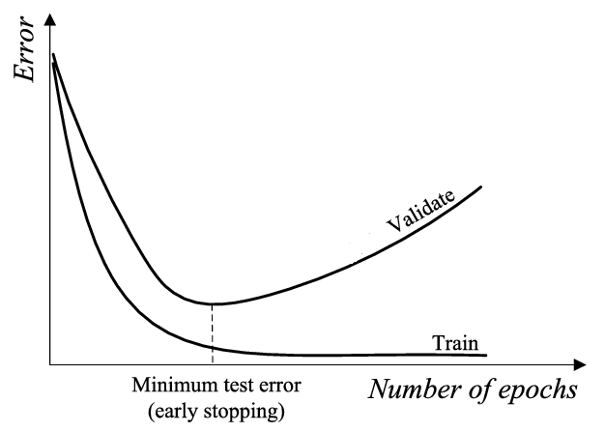
Early Stopping
Monitor training and validation loss or prediction error
Stop when validation loss or prediction error start to rise again….
Select model with minimum validation error

Slide 26
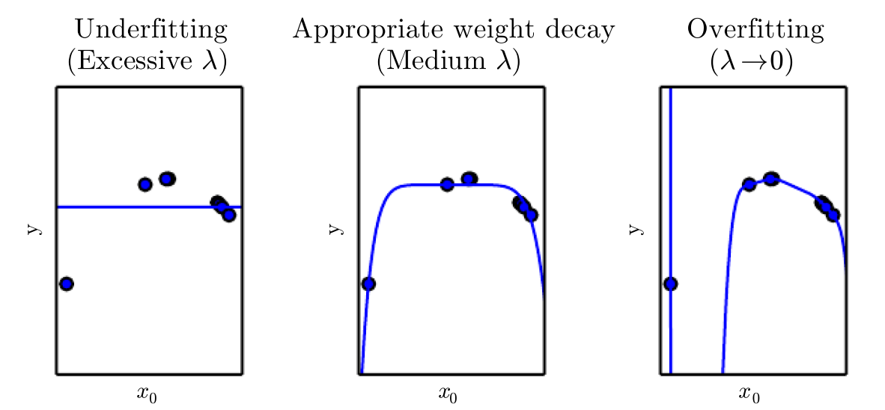


Parameter Norm Penalties
Limiting the model capacity by constrain the parameter norm
Selection of $λ$ is not easier task….
$$\hat{E}(w)=E+λw^{T}w$$

Slide 27
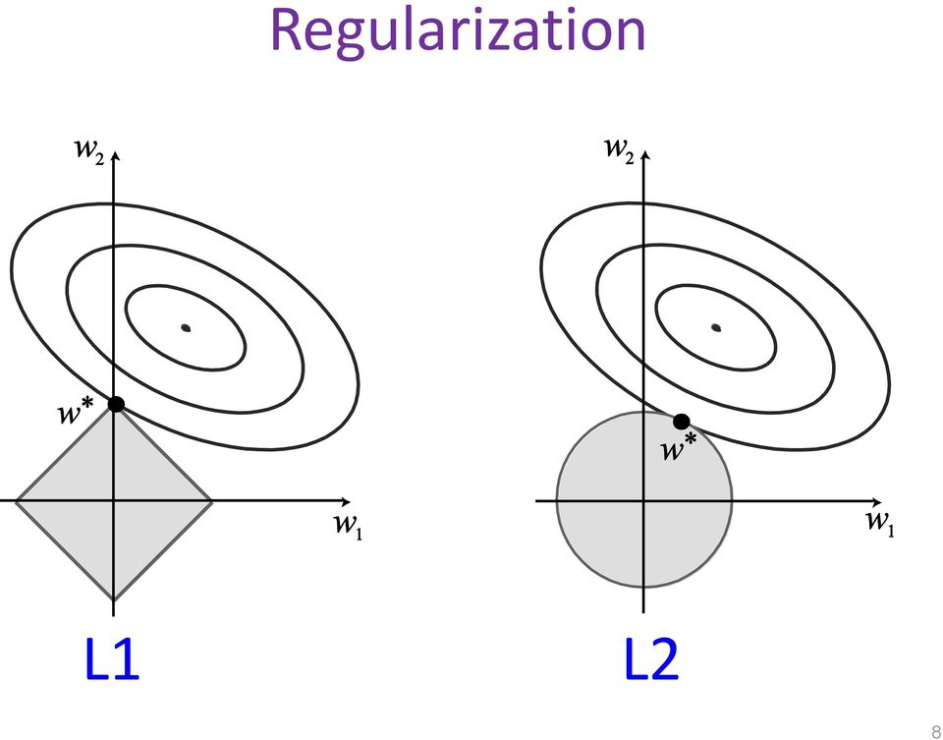

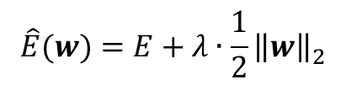

Parameter Norm Penalties
L² Regularization
Minimize the L² norm of the parameters
It restrict weight to become larger
$$\hat{E}(w)=E+λ∙\frac{1}{2}{\left\|w\right\|}_{2}^{}$$
$$w←w−η∇E−ληw$$
$$w←\left(1−λη\right)w−η∇E$$

Slide 28


Parameter Norm Penalties
L¹ Regularization
Minimize the L¹ norm of the parameters
Induce sparsity into the network
$$\hat{E}(w)=E+λ∙{\left\|w\right\|}_{1}^{}$$
$$w←w−η∇E−λ∙η∙sign(w)$$

Slide 29
Adding Noise
Adding a noise to the Data (data augmentation !!)
It make the input space smoother and easy to learn
Model become robust to the noise
Resulting in better generalization error
Choice of noise is application dependent
Noise can be added
to activations
to weights
to gradients
To outputs

Slide 30
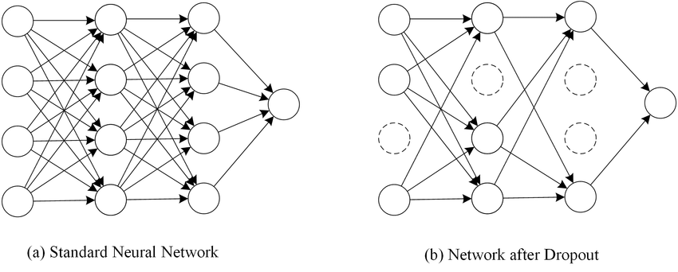
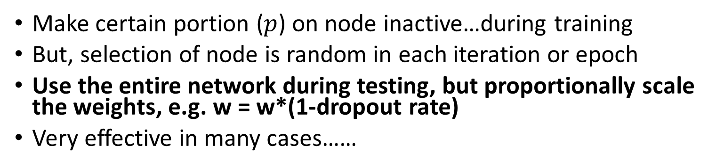



Node Dropout
Make certain portion ($p$) on node inactive…during training
But, selection of node is random in each iteration or epoch
Use the entire network during testing, but proportionally scale the weights, e.g. w = w*(1-dropout rate)
Very effective in many cases……
$$p=0.25$$
$$p=0.25$$
$$p=0.5$$

Slide 31
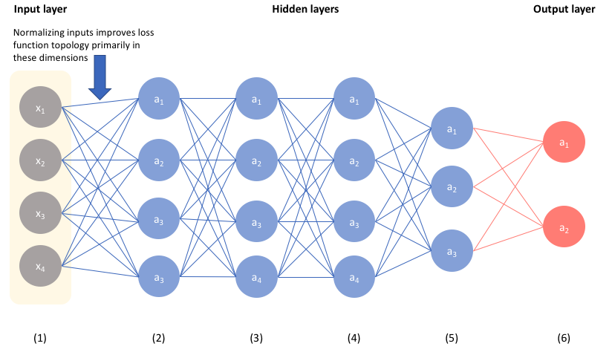

Batch Normalization
Normalizing output of hidden layers
Ioffe and Szegedy et. al. 2015
Internal co-variance shift: dynamic range of z change to bigger or may smaller in deep layer
$$z=w_{0}+\sum_{m=1}^{M}{w_{m} x_{m}}$$

Slide 32
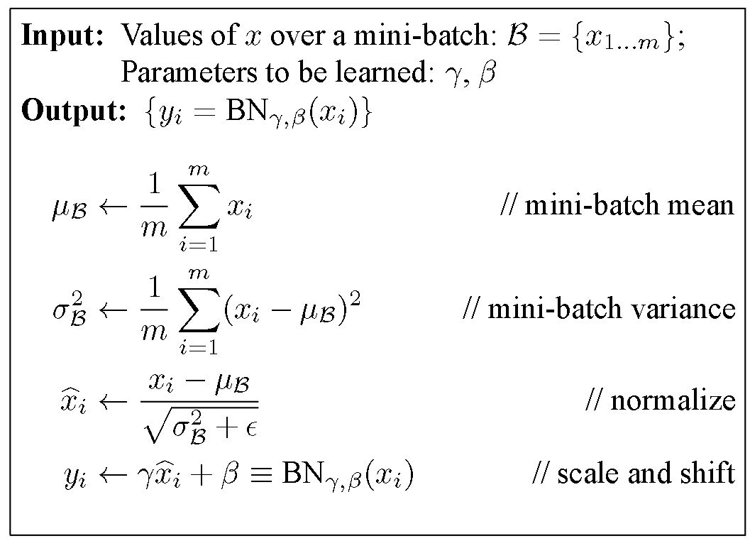
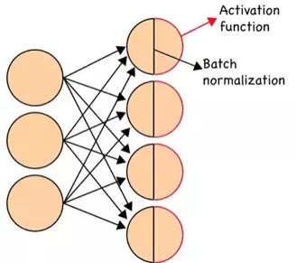
Batch Normalization
Training
In practice, BN used after activation function

Slide 33
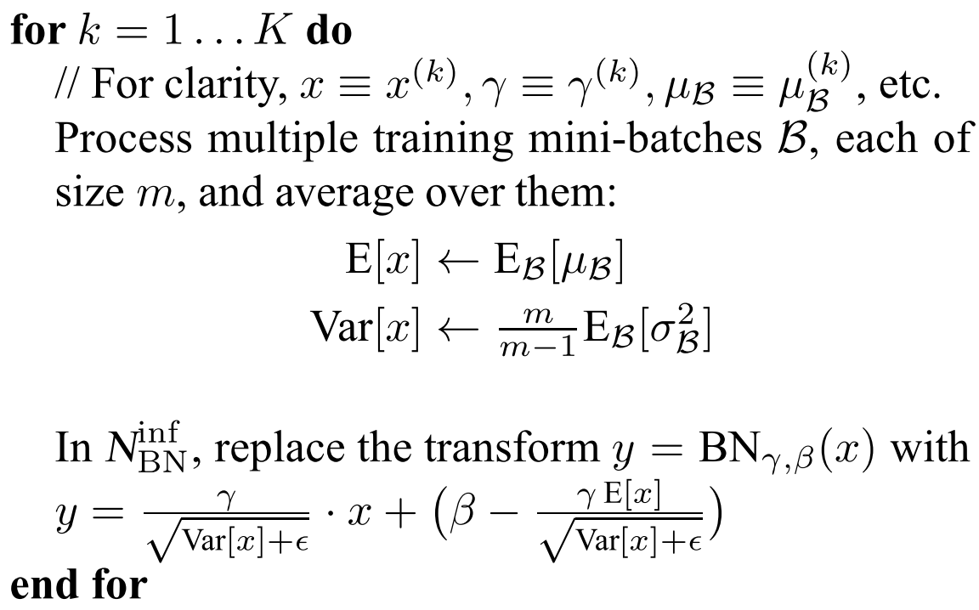
Batch Normalization
Testing
Track mean and variance during training set
Apply this correction during testing

Slide 34
Batch Normalization
Use Batch Normalization along with following settings….
Batch normalization before or after activation(non-linearity)?
After activation function is more sensible and work well in practice!
Increase learning rate
Do not use Dropout
Shuffle training examples more thoroughly
Reduce the L2 weight regularization

Slide 35
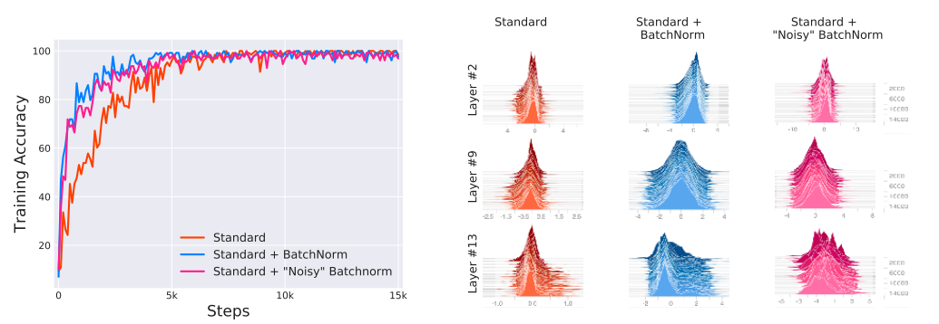
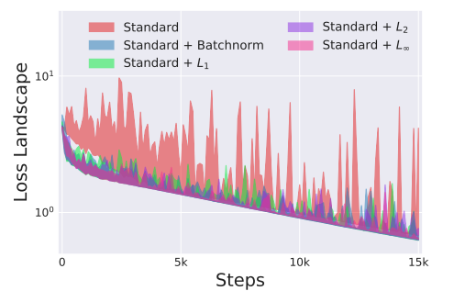
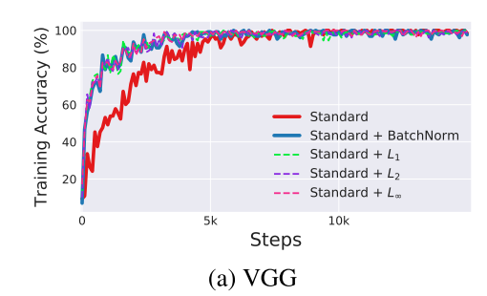
Batch Normalization
Why batch normalization do better job ?
How Does Batch Normalization Help Optimization? (No, It Is Not About Internal Covariate Shift, but a gradient smoothening ) Shibani Santurkar, et. al. Published 2018 in ArXiv

